Slide 1
Ego meets Eco
A strategy for the teaching of drawing
Howard Riley
Professor Emeritus, Swansea College of Art
University of Wales Trinity Saint David

Slide 2
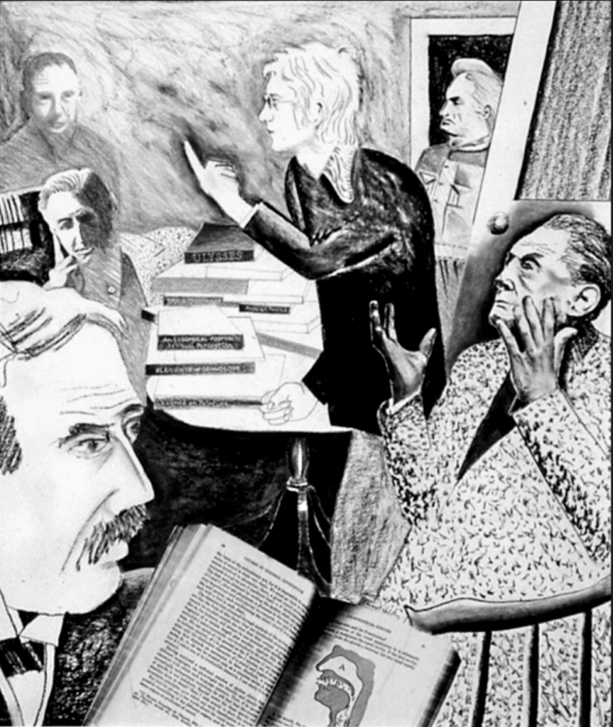
We as a network need to argue for the ‘primacy of drawing’ against the current neo-liberal pressures on our curricula.
Articulating our theoretical bases will lend credibility to the teaching of drawing as the most direct, efficient means of nurturing an ‘intelligence of seeing’ in our students.
An intelligence appliable to all visual art practices.
Notes:
Howard Riley ‘Portrait of the Artist as a Young Theorist’. Centre: the Young Theorist. Anti-clockwise, from bottom left: Saussure, Jakobson, Derrida, J.J. Gibson, Barthes

Slide 3
Egological: Ecological:
Anti-Naturalism Naturalistic Realism
Edmund Husserl’s ‘Egological’ approach studies the structures of consciousness subjectively: objects as they appear through our sensations.
James J. Gibson’s ‘Ecological’ explanation of visual perception is direct: based on our natural evolution to pick up visual information not mediated by sensations or sense-data.
Notes:
Concern about the demise of drawing from a curriculum driven by neo-liberal values.

Slide 4
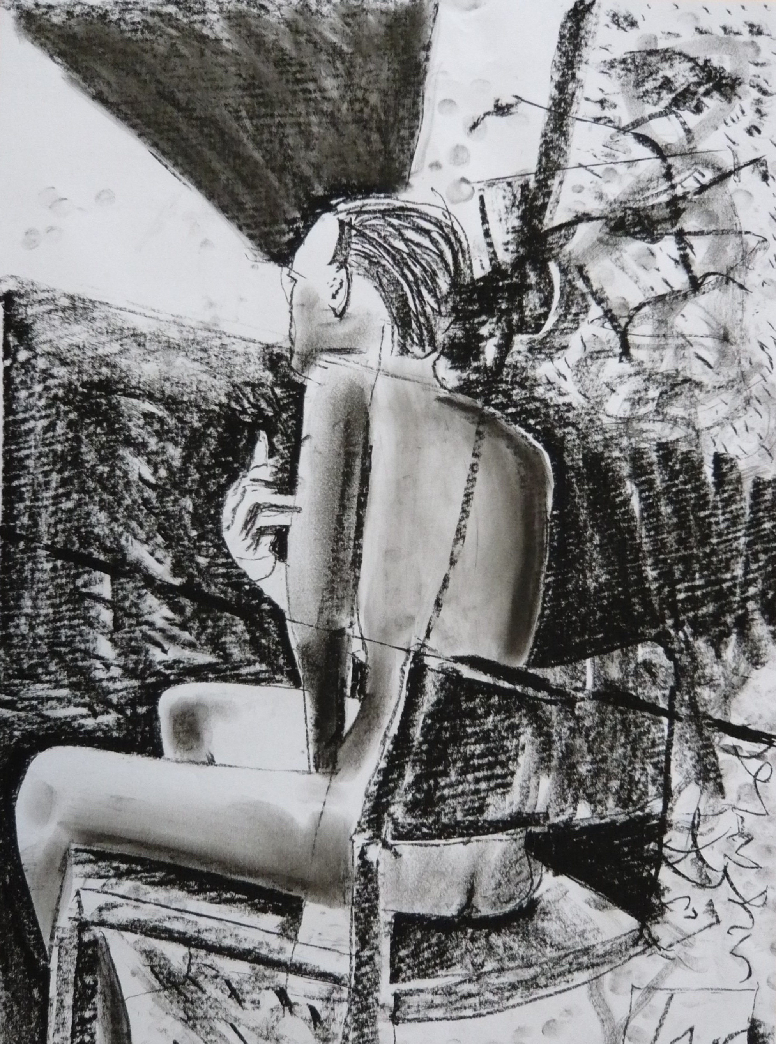
Egological
“…the ultimate source of all the formations of knowledge…bears the title I-myself”. (Husserl in Moran, D. 2005 Husserl. Founder of Phenomenology. Cambridge: Polity Press. p176).
Notes:
Husserl has been influential in recent drawing practices. He emphasise the subjective perception of reality.

Slide 5
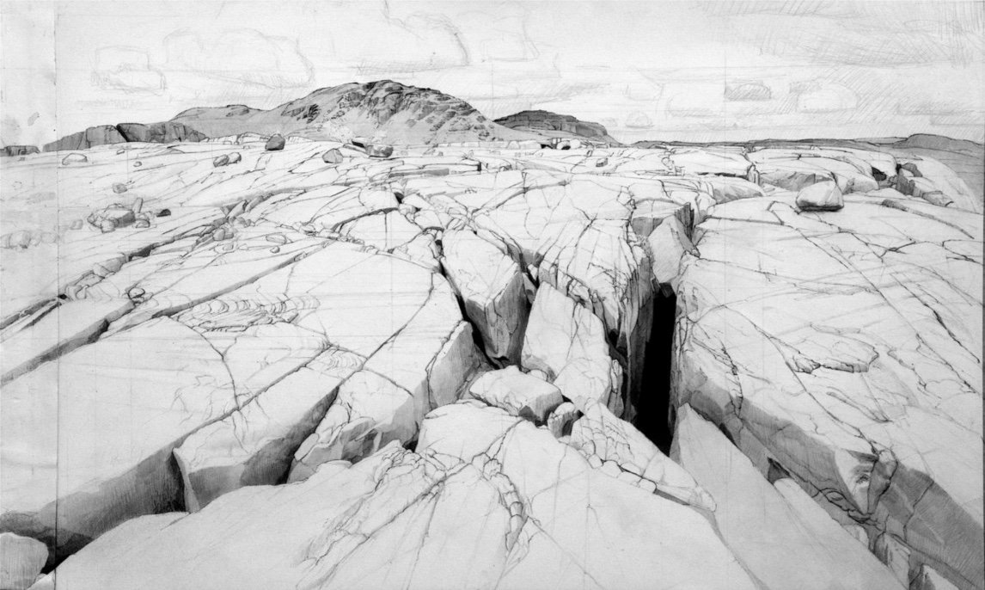
Ecological
“The supposedly separate realms of the subjective and the objective are actually only poles of attention. The dualism of observer and environment is unnecessary…Self-perception and environment perception go together”. (J.J. Gibson 1979 The Ecological Approach to Visual Perception. Boston: Houghton Mifflin p116)
Image: Robert Newell
Notes:
James J. Gibson is also highly relevant to any practices involved with perception. (Image: Robert Newell). He emphasises our dialectical relationship with our surroundings is the perception of reality.

Slide 6
Egological meets Ecological
Both Husserl and Gibson maintain that visual perception provides access to reality. The basic difference between them is to do with the nature of the relationship between perception and reality, a topic of inquiry surely of central relevance to all of us concerned in the visual arts?
Notes:
We have the opportunity to base a drawing programme on a dialectic relationship between Husserl and Gibson: Ego meets eco!

Slide 7
Egological meets Ecological
Pedagogical Applications
The theoretical bases of Husserl and Gibson are eminently applicable to drawing.
The duality between the viewer’s subjective positional activities and the properties and disposition of objects within the viewer’s environment, is implicit in the marks made and the systems of geometric projections devised in all cultures.
Notes:
Let’s look at each in turn:

Slide 8
Egological:
1 Attention to the inevitable relationships between medium, and the scale and textural properties bestowed upon the drawing by choices of media and ground (drawing surface).
2 Attention to the relationship between bodily gestures, and the subsequent marks’ potential to represent the passing of time and hand pressures applied. Also attention to gesture as response to external (or internal?) stimulii: the tradition of expressionist explorations, but with a degree of intentionality.
3 Attention to the range of geometrical projection systems which position a viewer – static or moving - in relation to objects in space.
Notes:
3 aspects of the egological attitude: Specifically, we can pay attention to the practice of drawing by applying an ‘Egological’ focus, and then ‘Ecological’ focus:

Slide 9
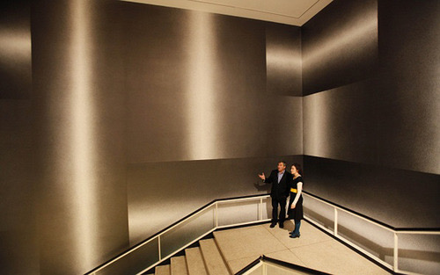
Egological 1
Medium related to Scale, Texture
Sol Lewitt 2010 Wall Drawing 1268: Scribbles: Staircase. Pencil on wall. Albright-Knox Gallery, Buffalo, NY.
(Examples where the rule ‘medium dictates scale’ is challenged).

Slide 10
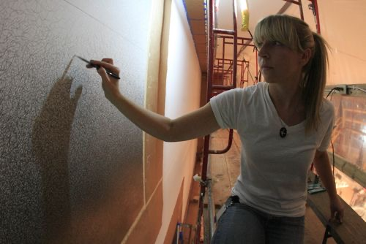
Medium, Scale, Texture
Sol Lewitt (and friends) 2010
54 days of scribbling for 7 hours a day, 16 artists worked for a total of 5,026 hours, using 1,717 pencil leads to complete this work.

Slide 11
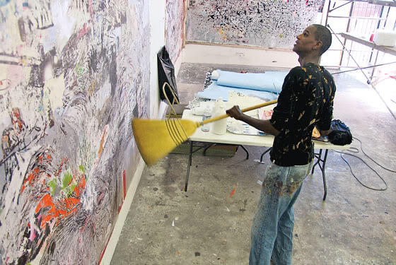
Medium, Scale, Texture
Mark Bradford 2007 at the Whitney Museum of Art, NYC.

Slide 12
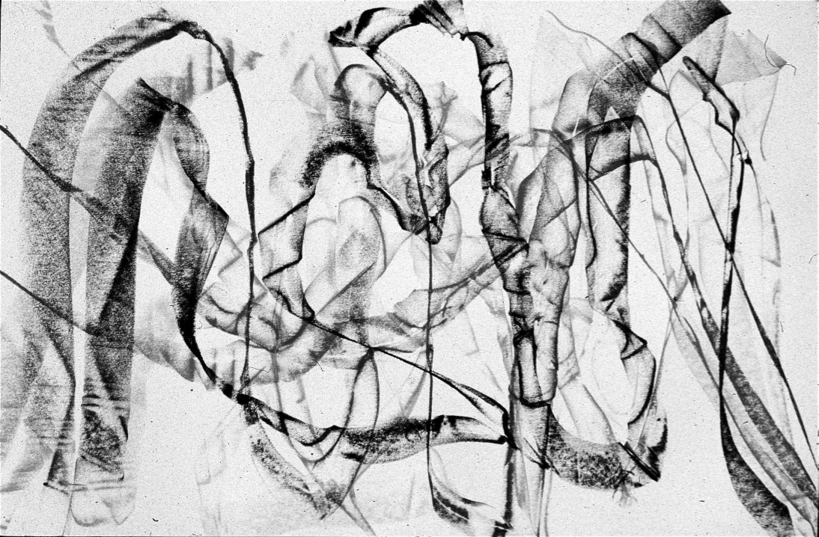
Egological 2
Bodily gestures of the drawer:
Speed of movement,
pressure of hand,
indicated in marks made.
Notes:
Robyn O’Grady

Slide 13
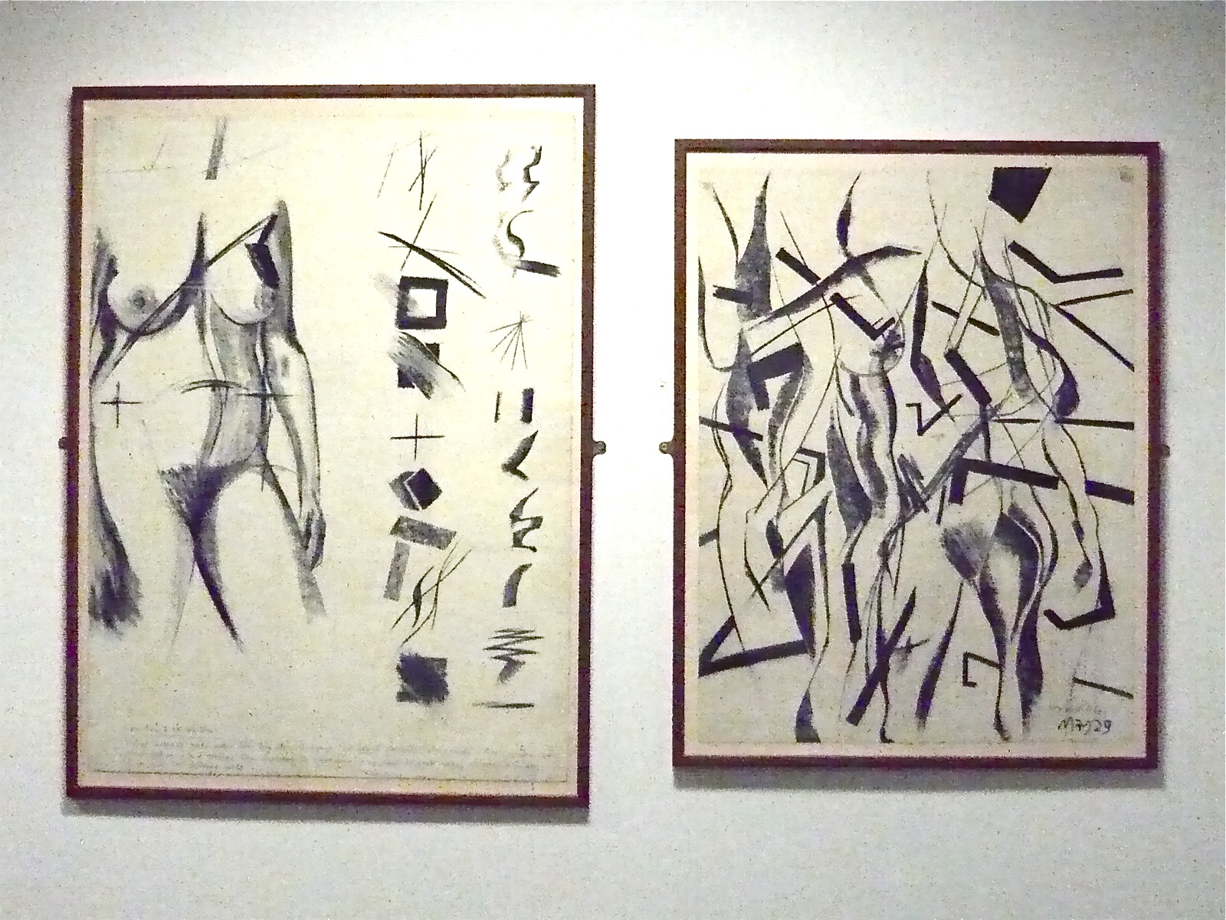
Bodily Gestures:
Gesture as expression in response to visual stimuli:
expression of relational insight, (rather than emotional reaction)
Notes:
Howard Riley ‘Life Drawing: Selections & Combinations’

Slide 14

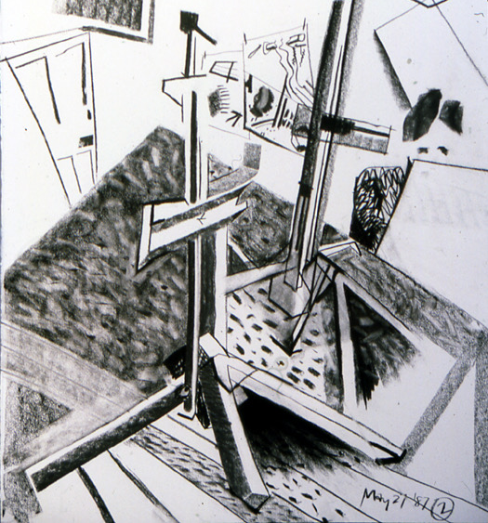
Egological 3
Projection systems related to:
Positioning of viewer in relation to environment:
static, or in motion.
Notes:
Howard Riley ‘Drawing Studio, RCA’

Slide 15
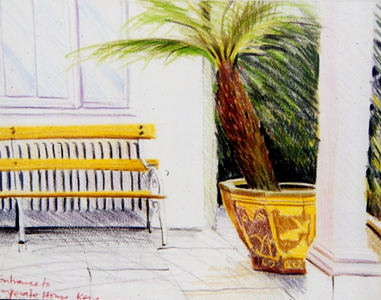
Viewer static, world static
Notes:
Howard Riley

Slide 16
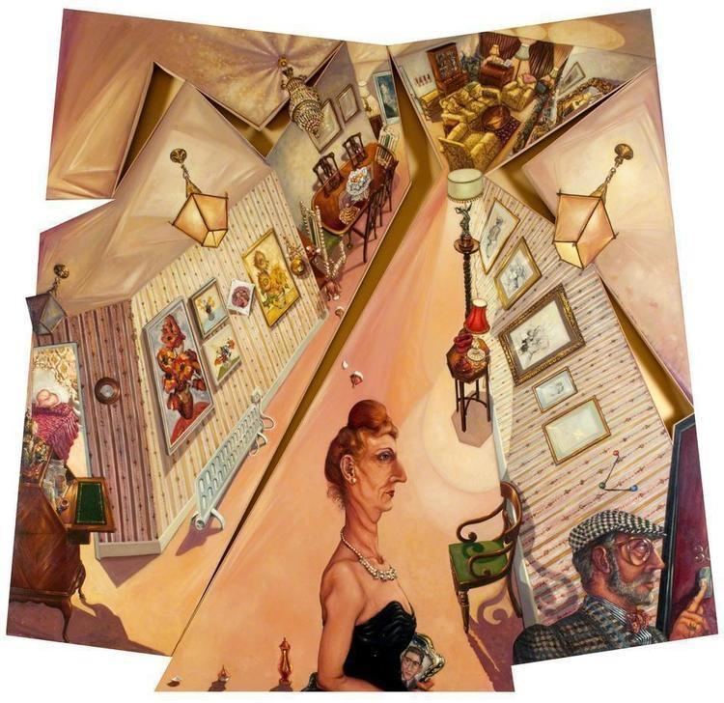
Viewer moves, world static
Anthony Green
Notes:
Anthony Green

Slide 17
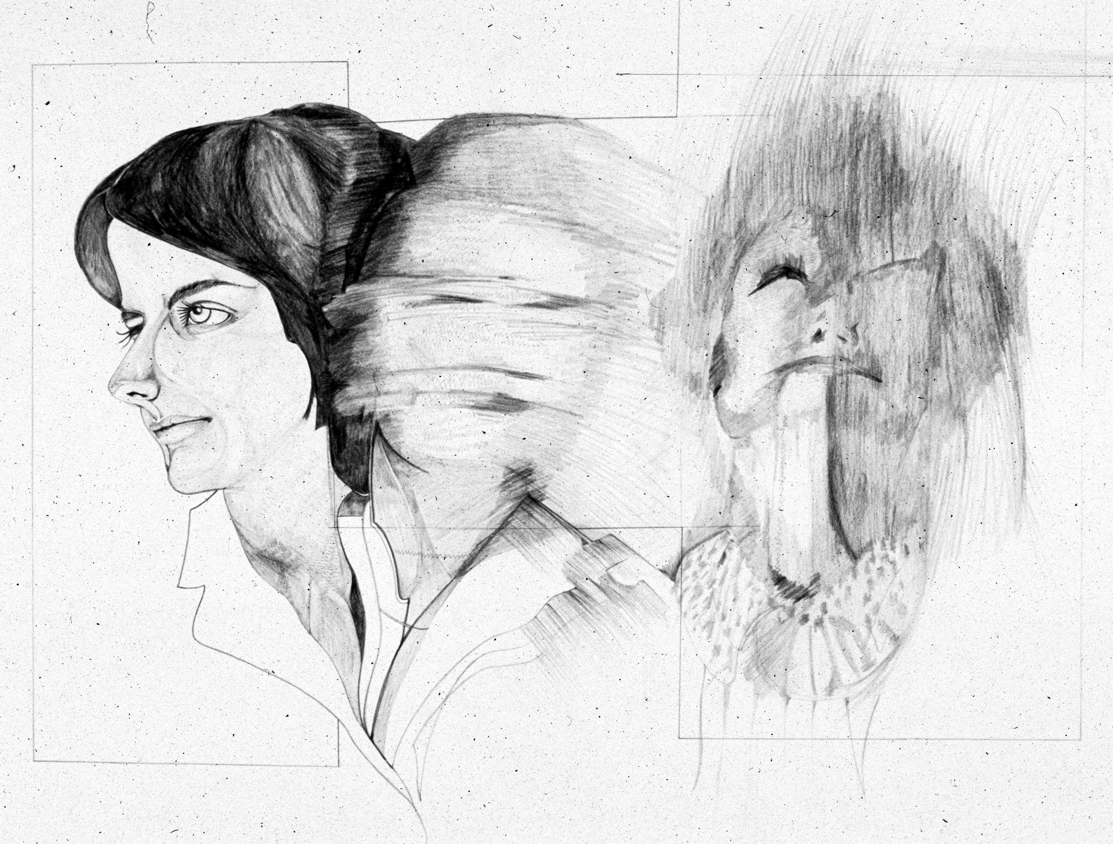
Viewer static, world moves
Lorita Saunders
Notes:
Lorita Saunders

Slide 18
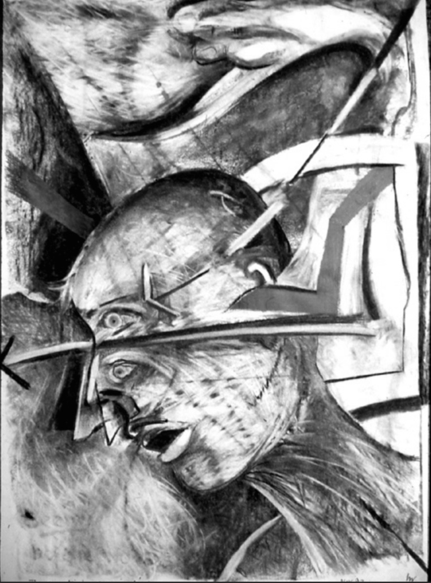
Viewer moves, world moves
Notes:
Howard Riley

Slide 19
Ecological:
1 Attention to the ‘channels of perception’: the haptic, textural qualities of the subject matter; the distal, arrangement in space of the surfaces and edges within the scene; and the proximal, the overall flat pattern qualities of the scene.
2 Attention to gradations of tone and texture representing distance, and the inclination of surfaces relative to the viewer.
3 Attention to cross-cultural systems of projective geometry designed to represent the relationships between objects in space and a viewer’s possibilities of placement.

Slide 20
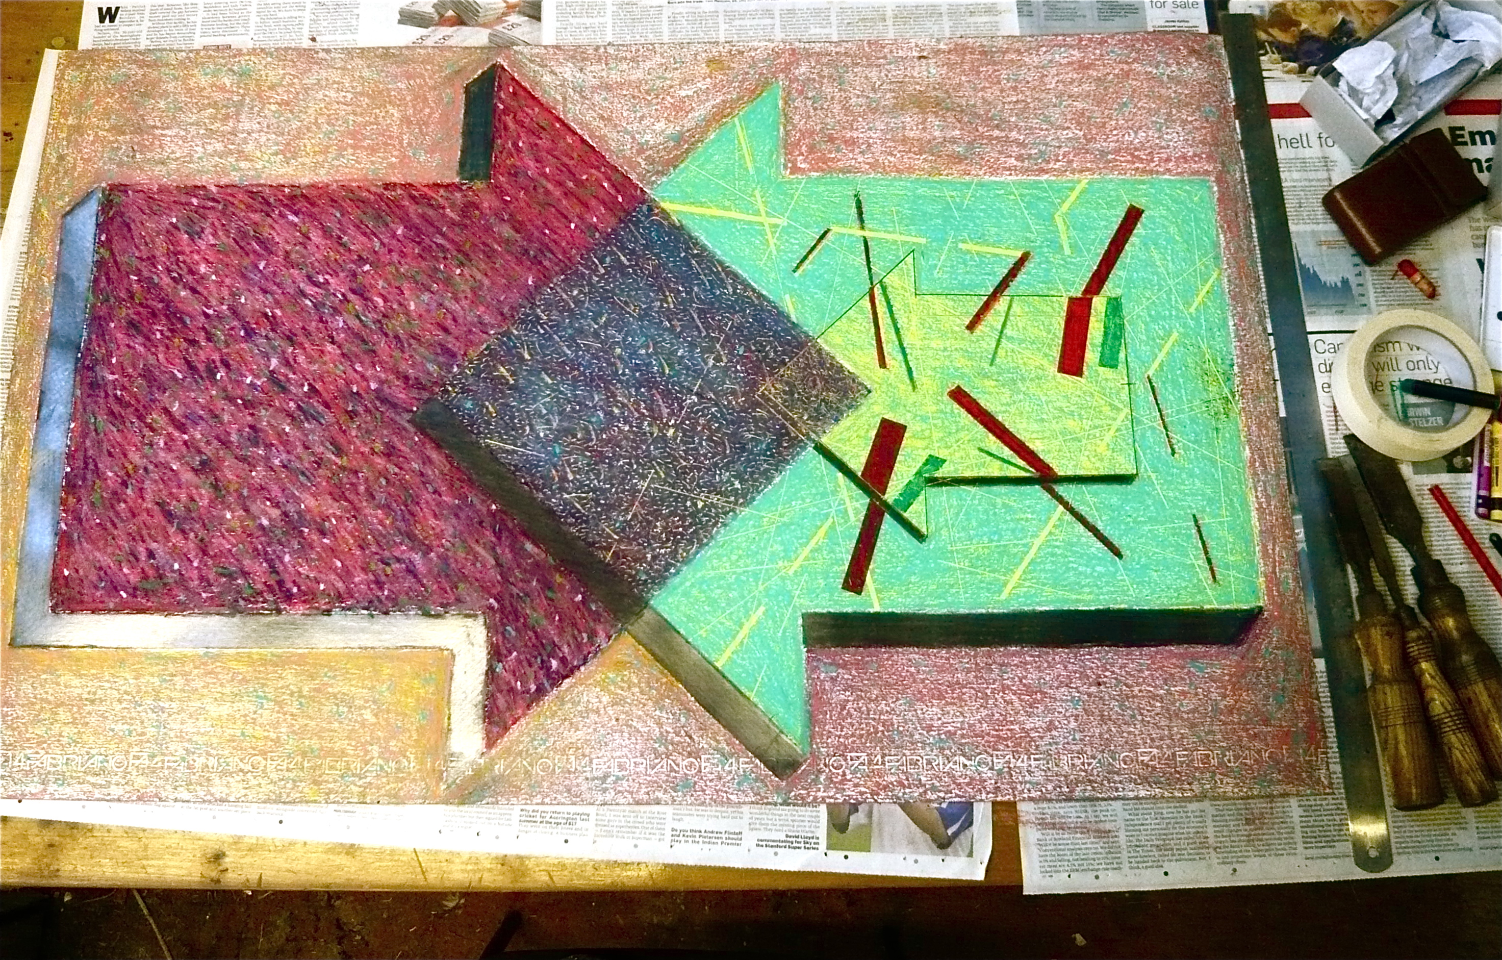
Ecological 1: Channels of perception
Haptic channel
‘Surface Qualities + Illusions of Depth = Visual Delight’
Notes:
Howard Riley

Slide 21
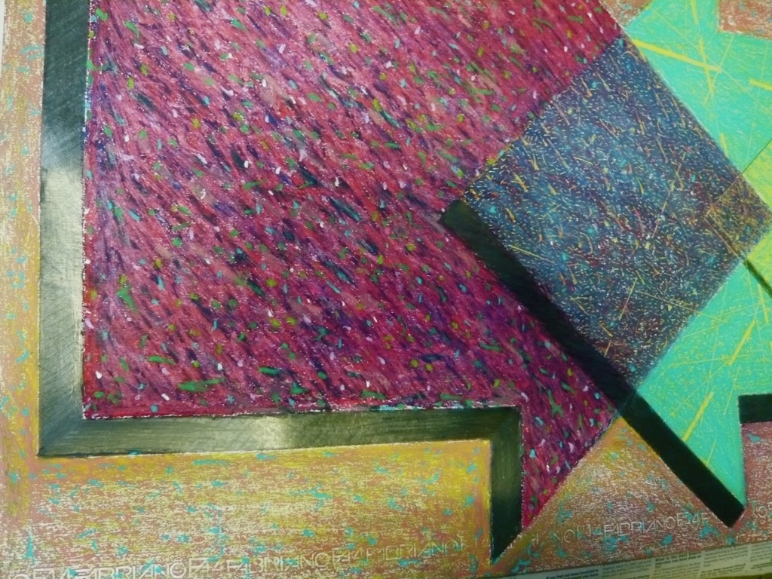

Slide 22
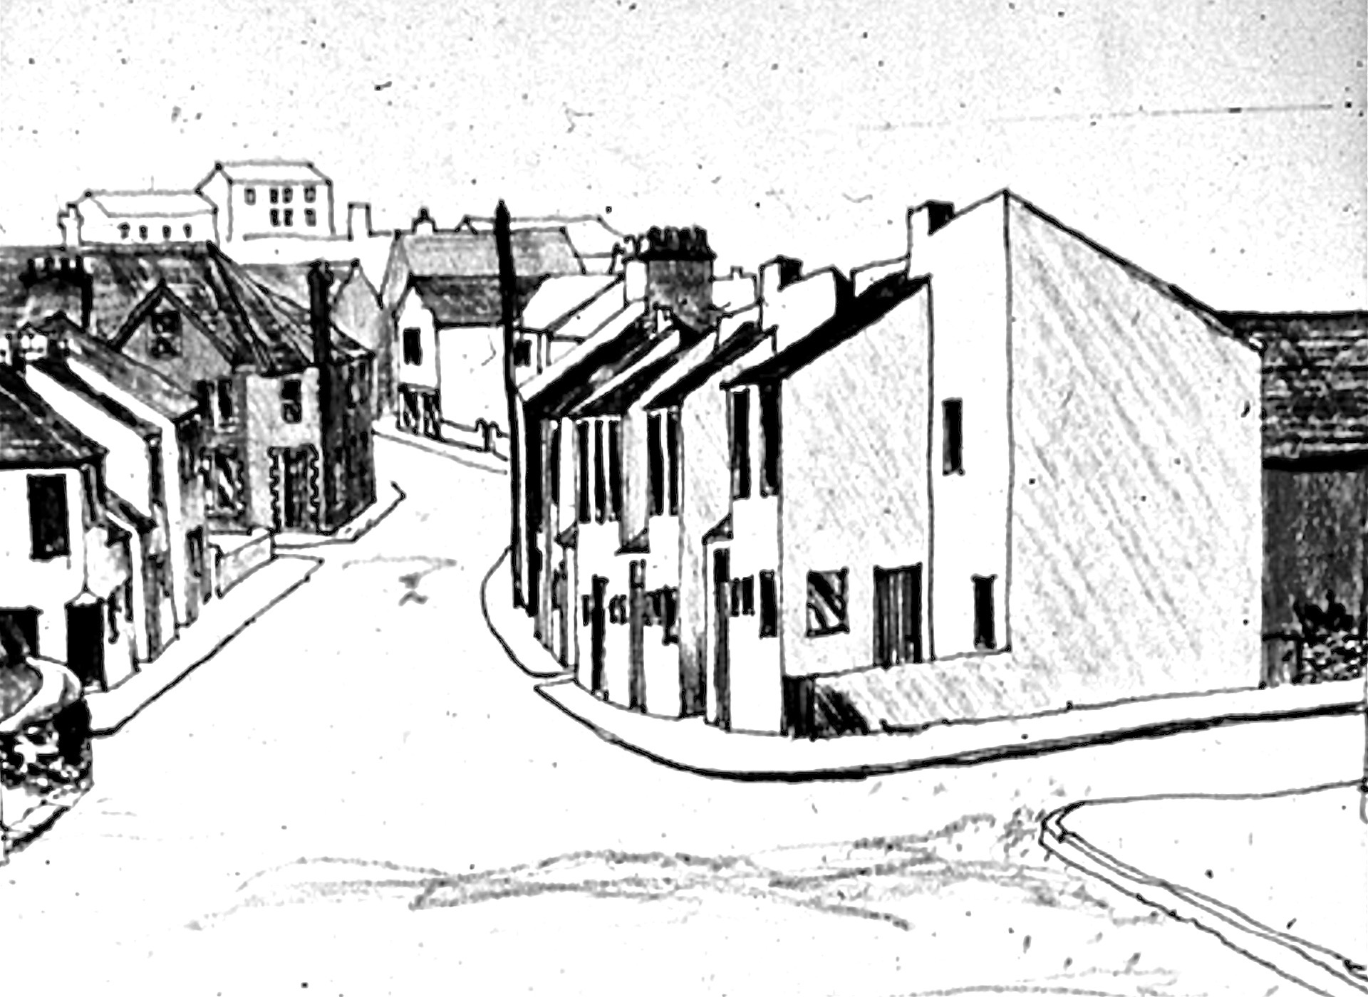
Distal channel
Emphasis on cues for depth.
Notes:
Howard Riley ‘Glyncorrwg’

Slide 23
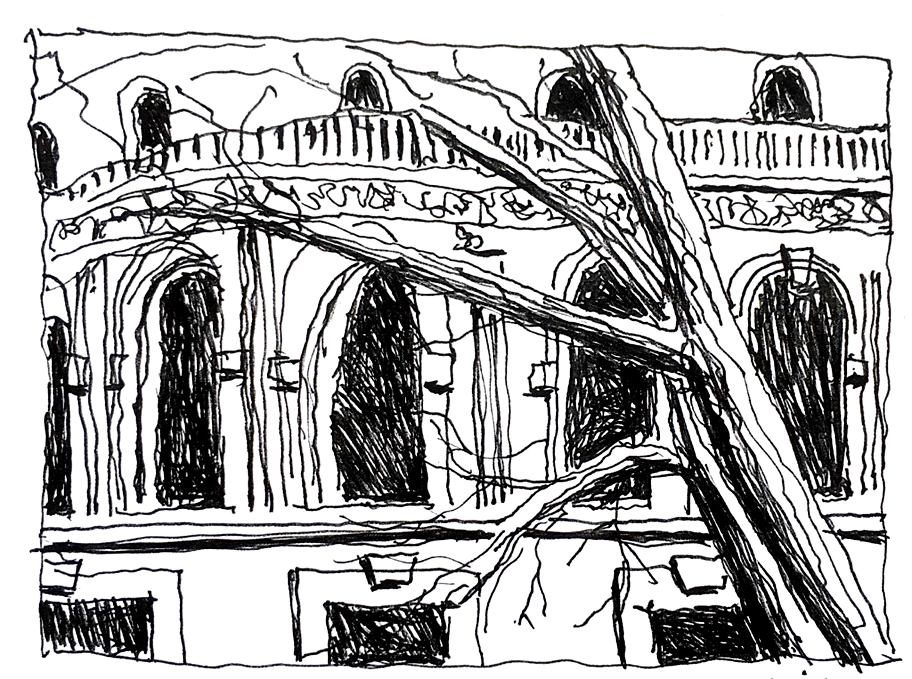
Proximal channel
Emphasis on flat pattern of visual field.
Notes:
Howard Riley ‘Albert Hall from the SCR of the RCA’

Slide 24
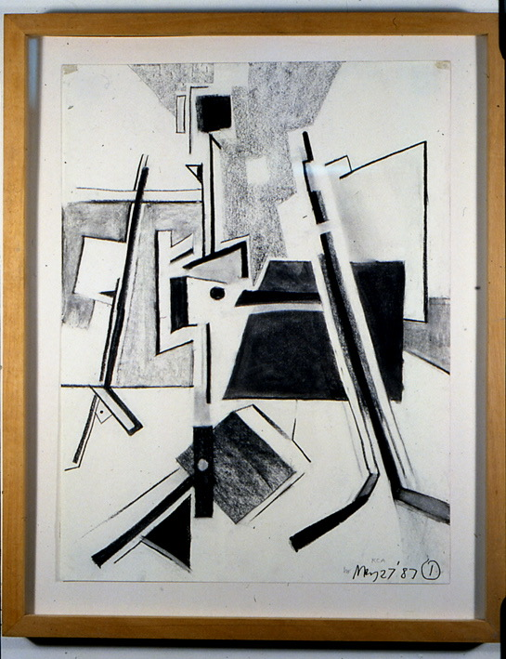
Ecological 2
Gradation of Tone, Texture:
Indications of Distance; Inclination of Surfaces
Notes:
Howard Riley ‘The Drawing Studio, RCA’

Slide 25
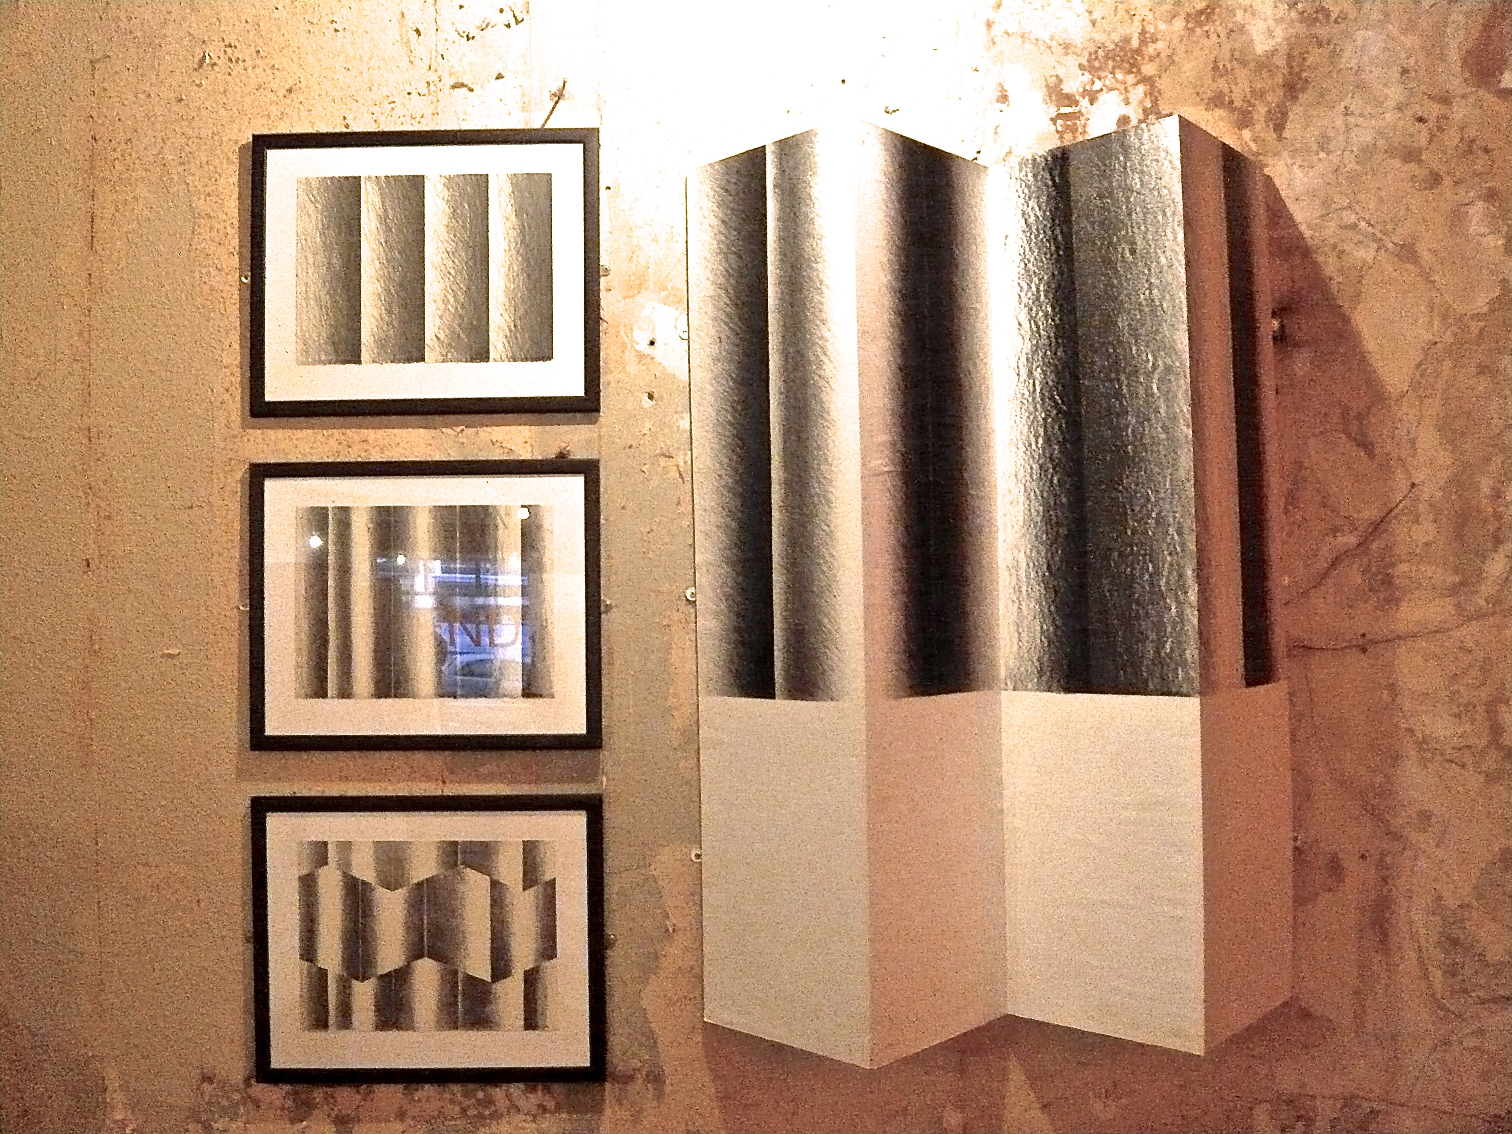
Gradation of tone and texture
Notes:
Howard Riley ‘homage to Howard Taylor’

Slide 26
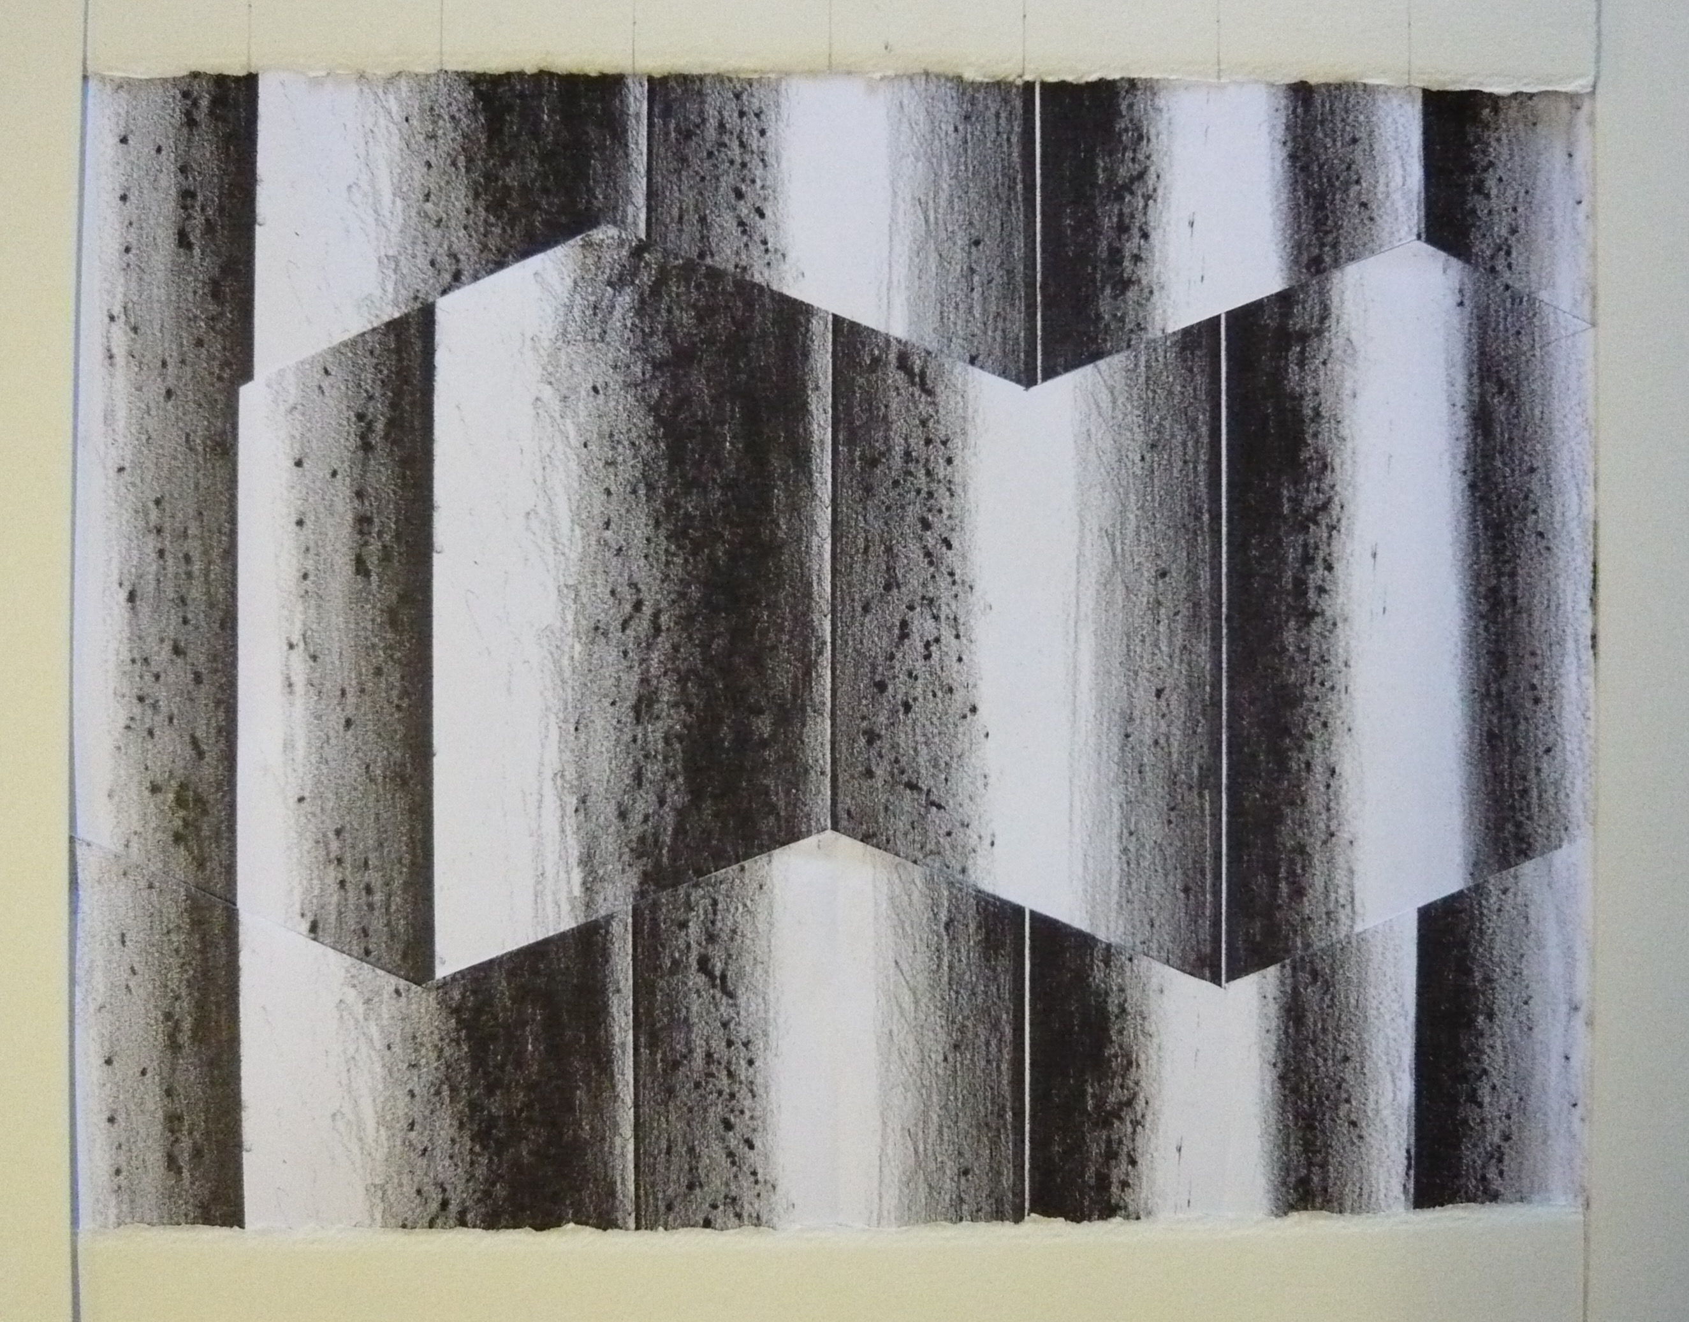
Gradation of tone/texture:
Inclination of surfaces
Notes:
Howard Riley

Slide 27
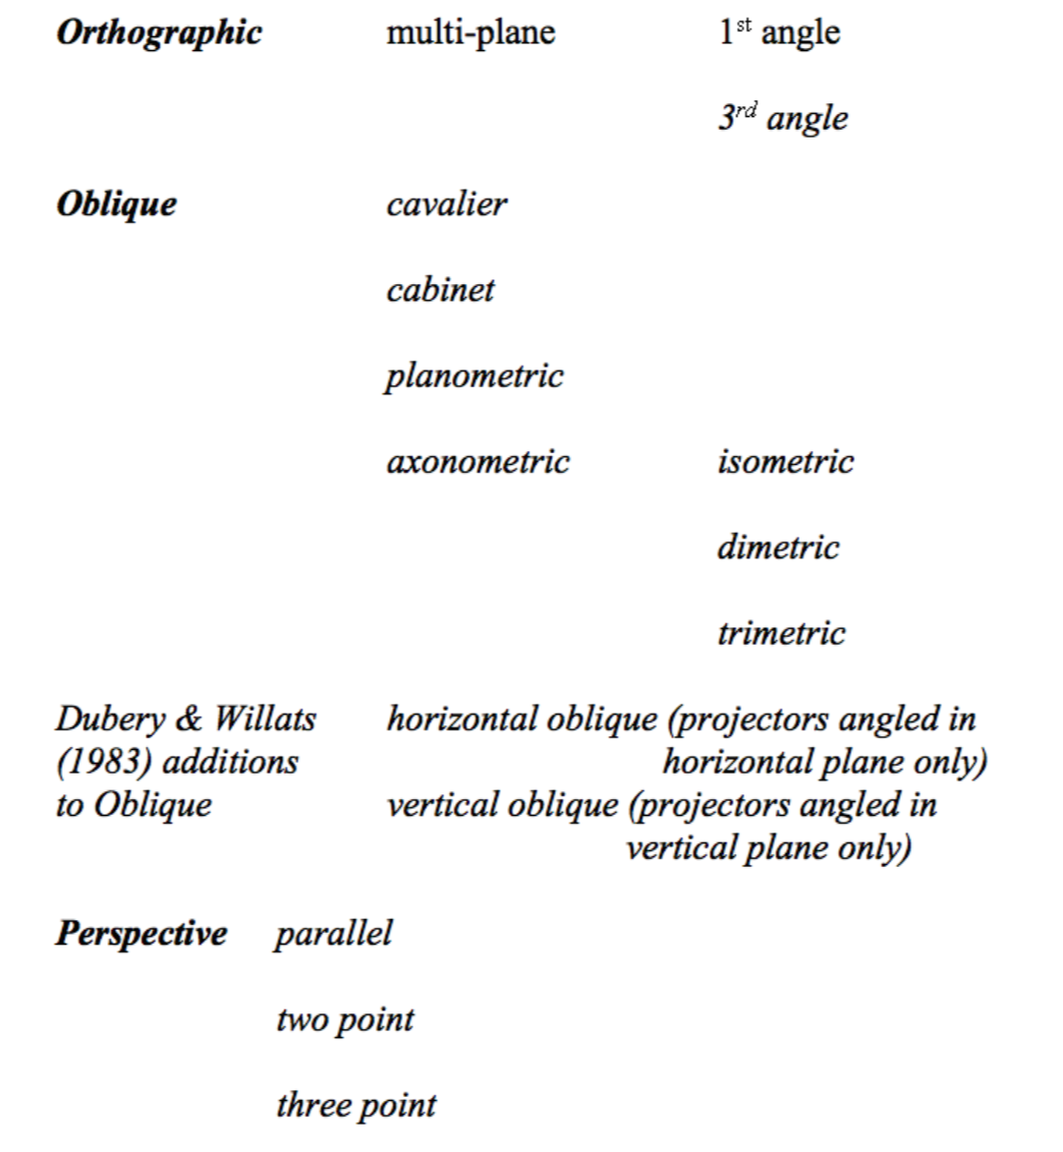
Ecological 3
Cross-cultural systems of geometrical projection:
Relations between viewer and objects

Slide 28
Egological meets Ecological
through geometrical projections:
… perceiving the environment includes the ego as part of the total process. In order to localize any object, there must be a point of reference. An impression of ‘there’ implies an impression of ‘here’, and neither could exist without the other. (J.J. Gibson 1950 The Perception of the Visual World. Boston: Houghton Mifflin p226)
Notes:
Gibson 1950 ‘The Perception of the Visual World’ Boston: Houghton Mifflin

Slide 29
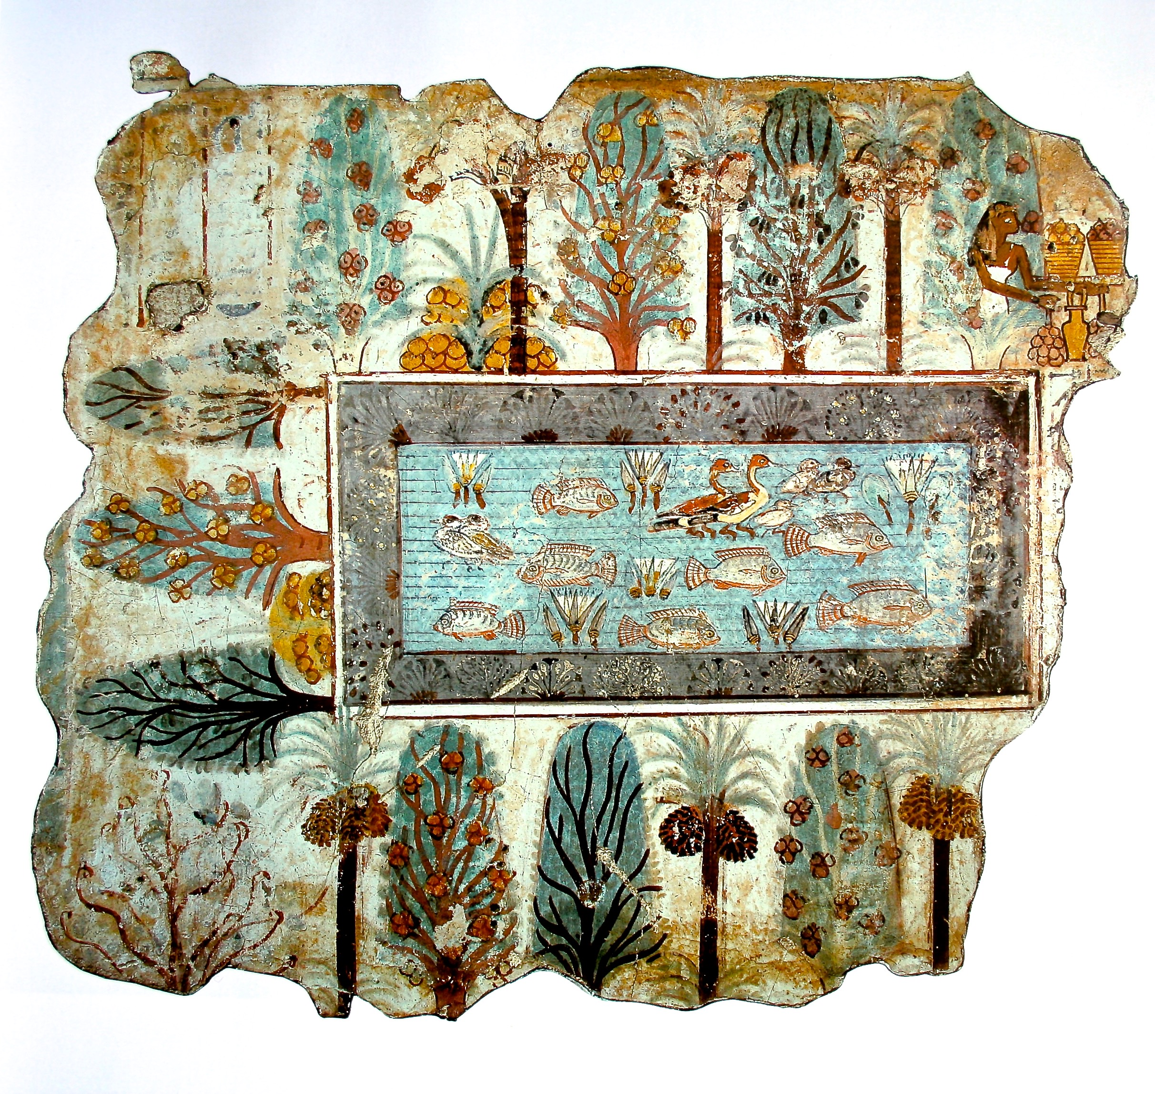
Orthographic
Projection
Egyptian 1350BC
Tomb of Nebamun
Wall painting, fragment
British Museum
Notes:
Egyptian wall painting

Slide 30
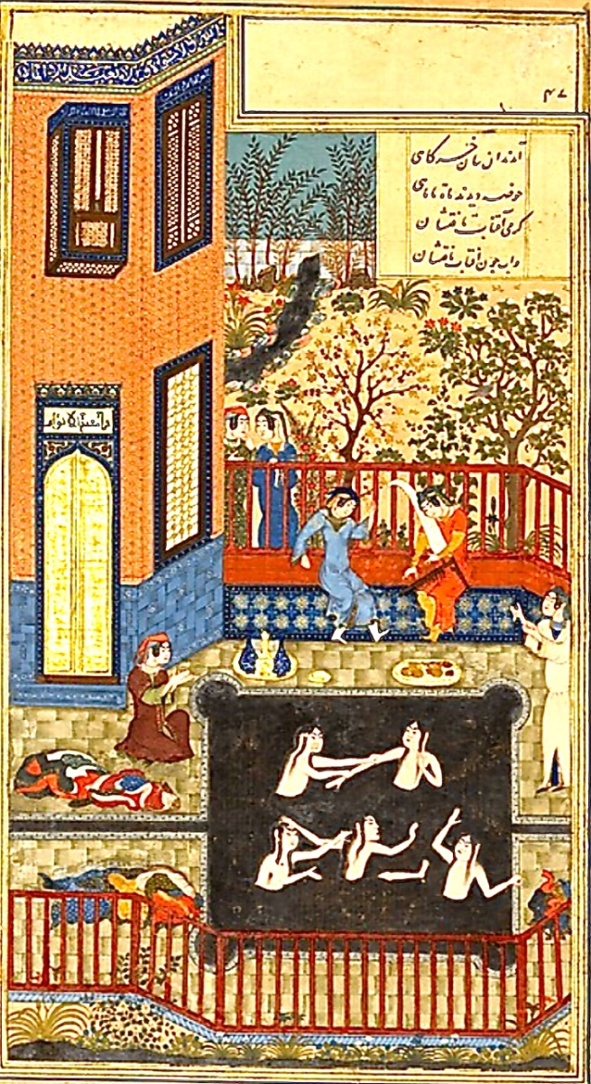
Oblique projection
Nizami (Afghanistan) c1430 The Eavesdropper. Ink and gold on paper. 28x18cms. MetMuseum NYC.

Slide 31
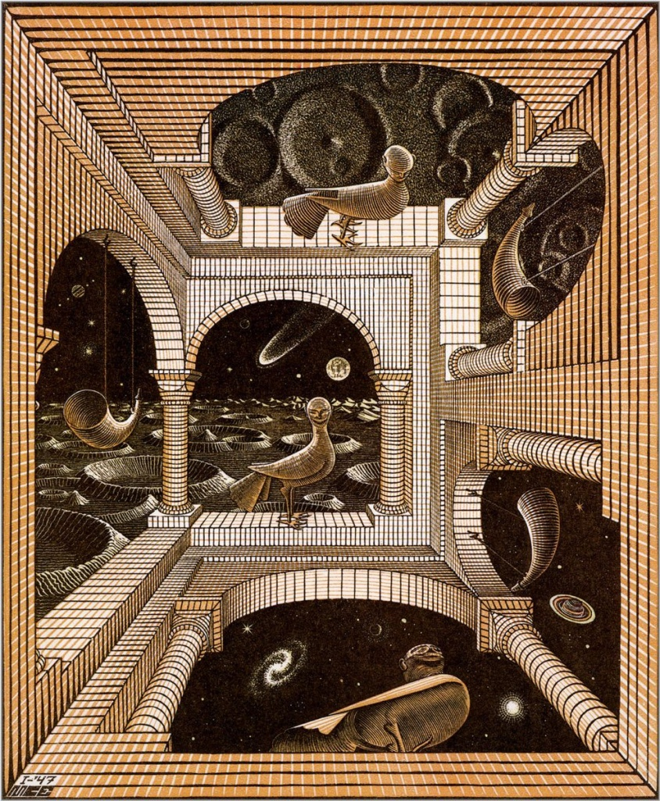
Perspective projection
M.C. Escher 1947 Another World

Slide 32
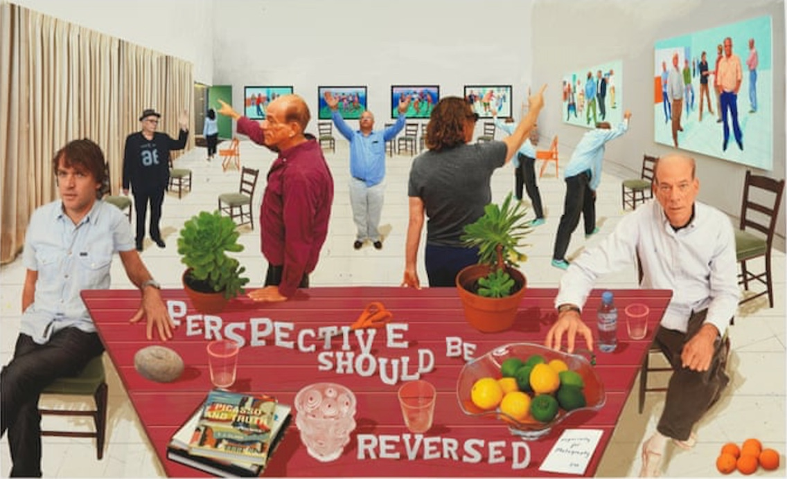
Other projection systems?
David Hockney

Slide 33
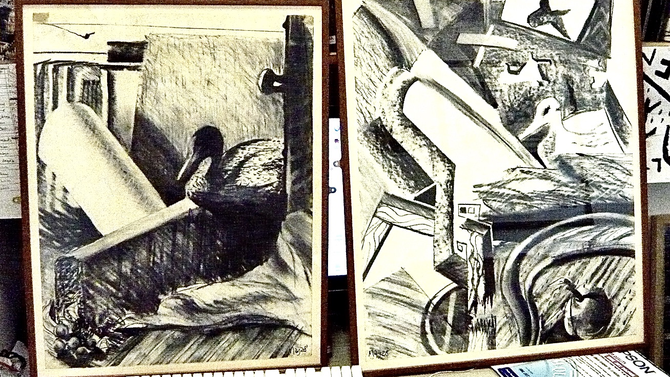
Both Ego and Eco themes may inform drawing pedagogy

Slide 34
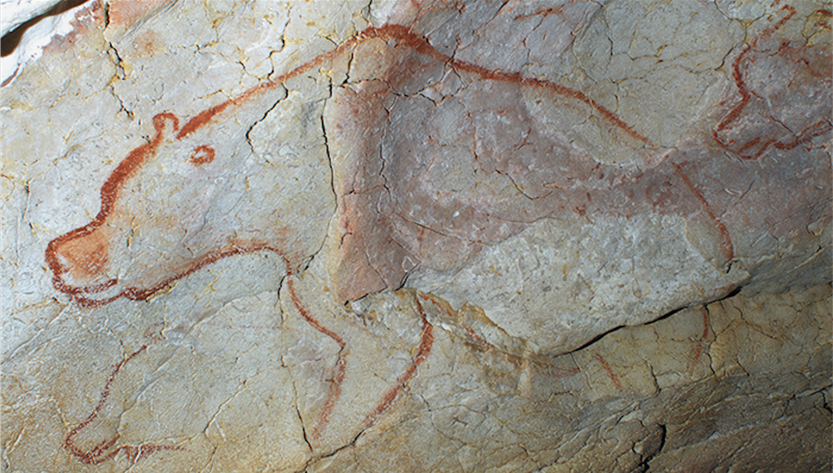
howard.riley@uwtsd.ac.uk
https://www.researchgate.net/profile/
Howard_Riley

